Slide 1
Finding a suitable area for burger queen joints
Garry Putranto Arimurti

Slide 2
Introduction
CEO of Burger Queen wanted to open 3 new branches in each borough in Toronto excluding East Toronto and Central Toronto
As the brand is relatively new, the CEO wanted 3 specific areas where it is not too close to rival joints to prevent early rival clash
However, it shouldn’t be too far to prevent lack of customer by opening in a low population area

Slide 3
How We Obtain the Data
To obtain the list of borough and neighborhood we extract them from https://en.wikipedia.org/wiki/List_of_postal_codes_of_Canada:_M
To obtain the longitude and latitude of each borough we extract them from http://cocl.us/Geospatial_data
To obtain the longitude and latitude of rival joints we get them via Foursquare API

Slide 4
How we process the data
We use K-means clustering with K = 3
K-means clustering is originally used to cluster areas and label them with the amount of label equals to K
We don’t need the label cluster, but instead we use the centroids to determine where to build the joints
The centroids should be strategically placed in a place not too far away and not too close to the rival joints, satisfying the requirements set by the CEO
We use n_init = 10 in order to do the K-Means 10 times and find the best result from the 10 trial

Slide 5
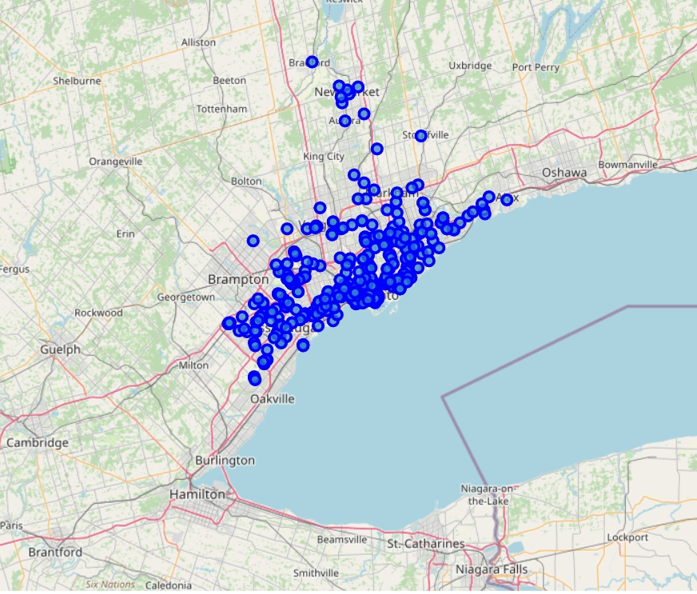
Established Burger Joints in Toronto

Slide 6
Results

Slide 7
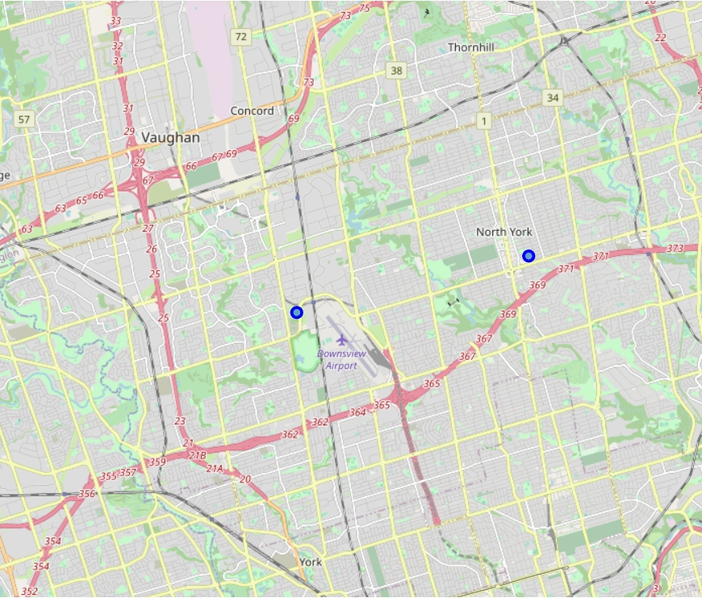
North york

Slide 8
North York Area Coordinates
No. | Latitude | Longitude | Location
1 | 43.752712 | -79.340172 | Area 1
2 | 43.751081 | -79.484132 | Area 2
3 | 43.764950 | -79.405064 | Area 3

Slide 9
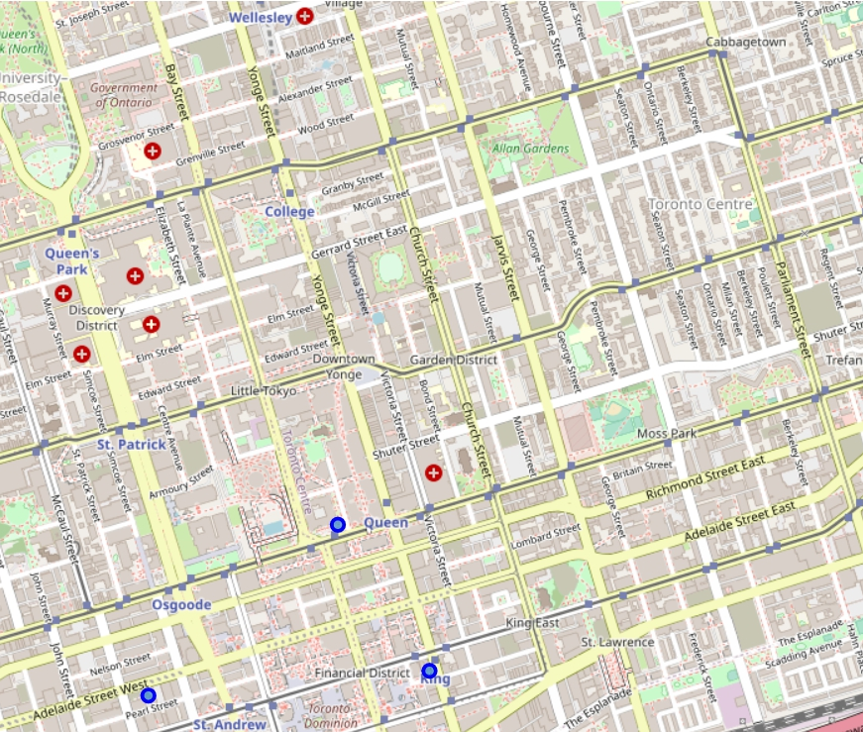
Downtown toronto

Slide 10
Downtown Toronto Area Coordinates
No. | Latitude | Longitude | Location
1 | 43.648052 | -79.387662 | Area 1
2 | 43.652350 | -79.381107 | Area 2
3 | 43.648685 | -79.377937 | Area 3

Slide 11
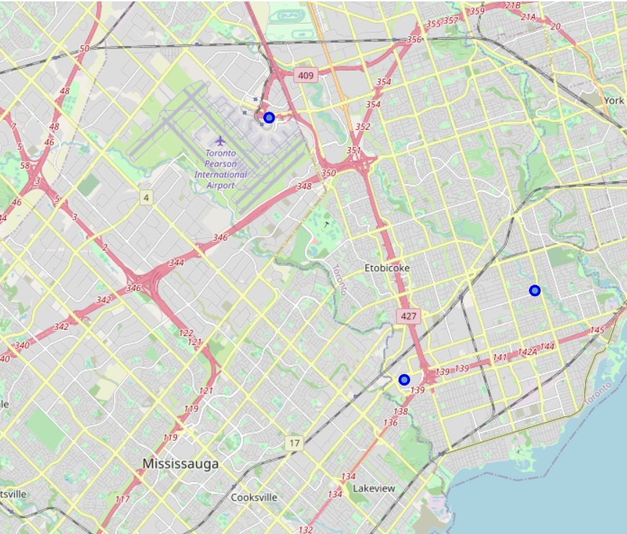
etobicoke

Slide 12
Etobicoke Area Coordinates
No. | Latitude | Longitude | Location
1 | 43.684930 | -79.610814 | Area 1
2 | 43.612806 | -79.559362 | Area 2
3 | 43.637401 | -79.509577 | Area 3

Slide 13
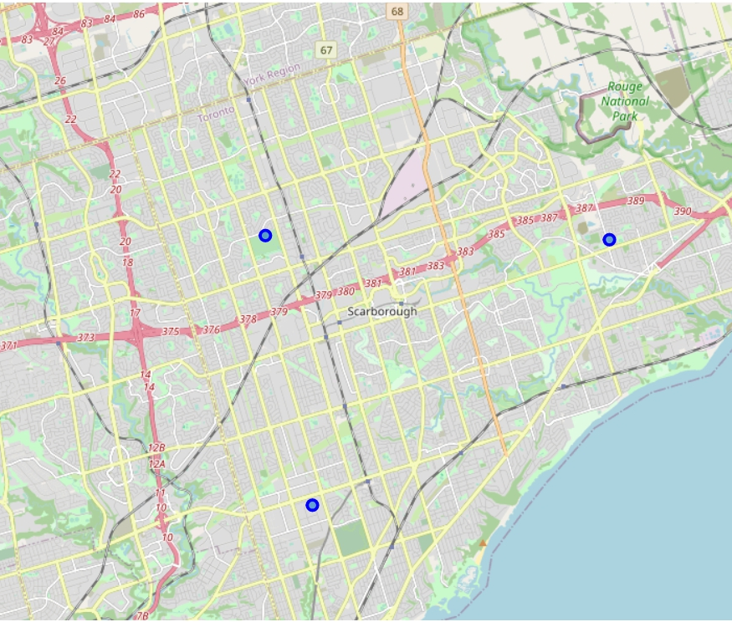
scarborough

Slide 14
Scarborough Area Coordinates
No. | Latitude | Longitude | Location
1 | 43.726828 | -79.280640 | Area 1
2 | 43.789862 | -79.183114 | Area 2
3 | 43.790821 | -79.296103 | Area 3

Slide 15
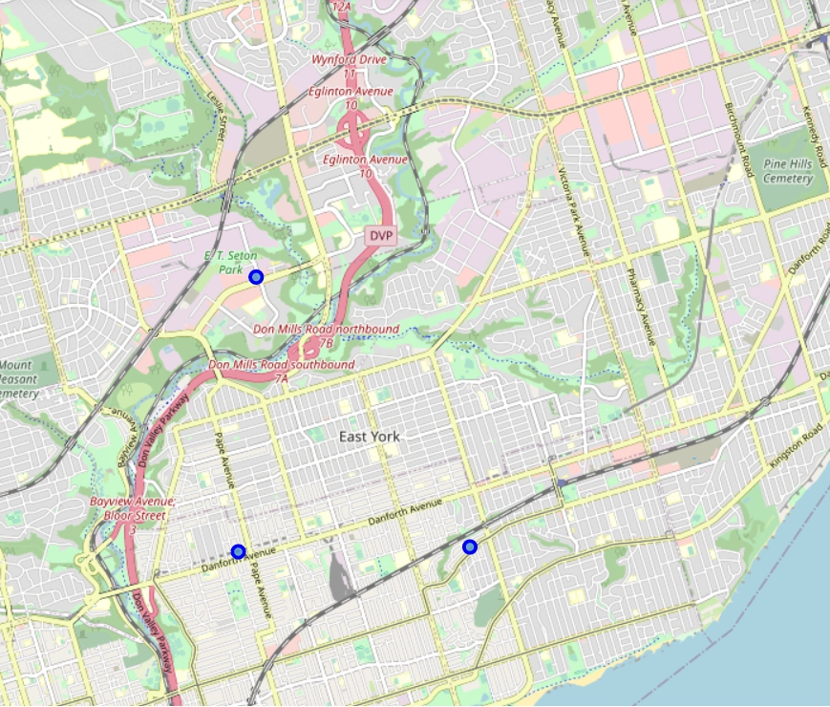
East york

Slide 16
East York Area Coordinates
No. | Latitude | Longitude | Location
1 | 43.679750 | -79.313439 | Area 1
2 | 43.679343 | -79.346659 | Area 2
3 | 43.707899 | -79.344037 | Area 3

Slide 17
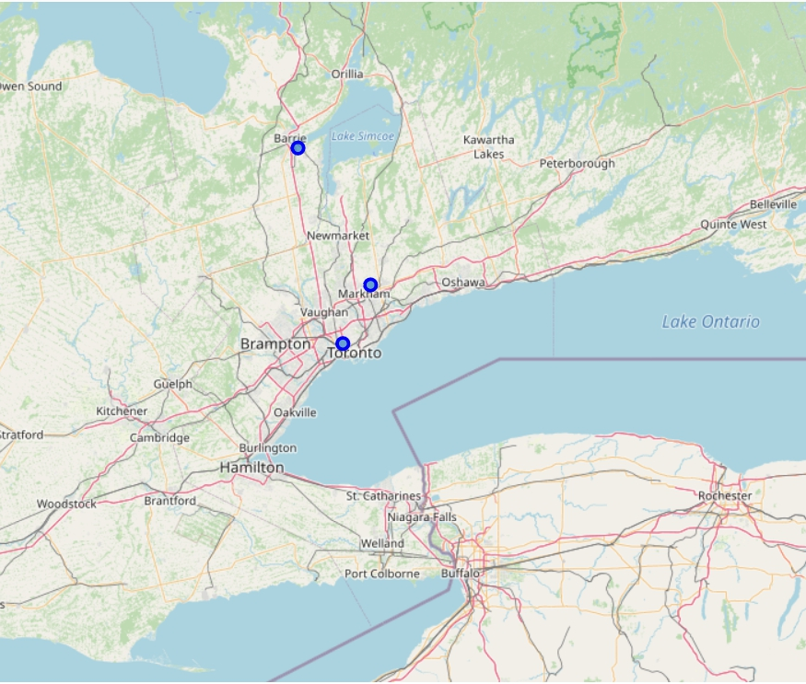
york

Slide 18
York Area Coordinates
No. | Latitude | Longitude | Location
1 | 43.684366 | -79.437440 | Area 1
2 | 44.353646 | -79.649221 | Area 2
3 | 43.886043 | -79.304222 | Area 3

Slide 19
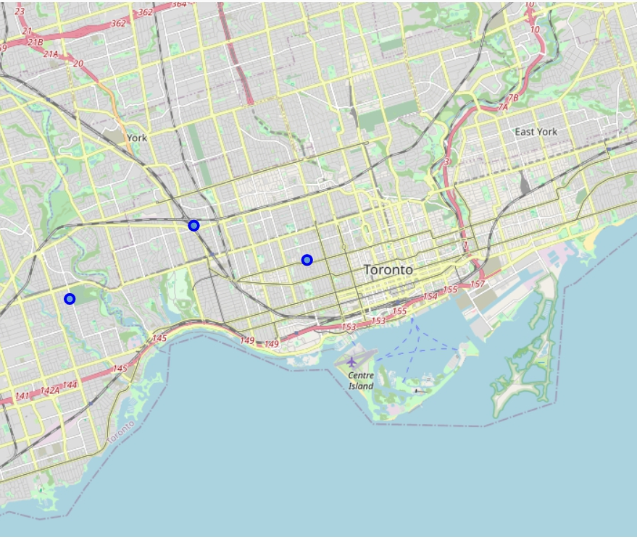
West toronto

Slide 20
West Toronto Coordinates
No. | Latitude | Longitude | Location
1 | 43.656157 | -79.414795 | Area 1
2 | 43.665515 | -79.457567 | Area 2
3 | 43.645609 | -79.504557 | Area 3

Slide 21
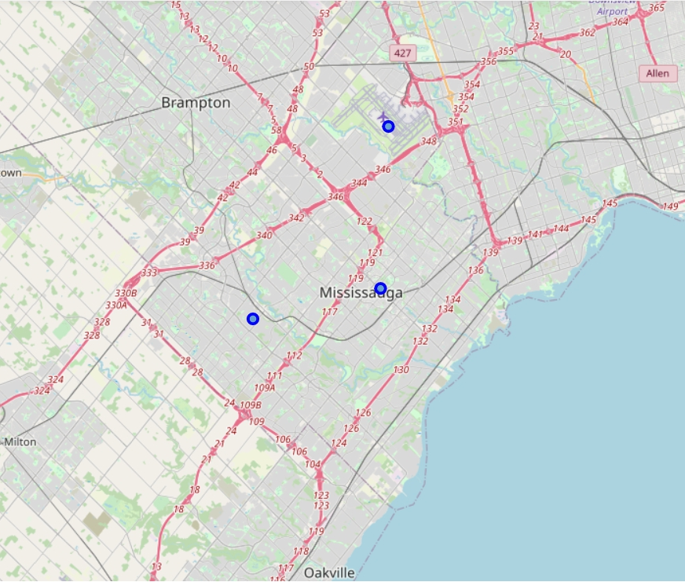
mississauga

Slide 22
Mississauga Coordinates
No. | Latitude | Longitude | Location
1 | 43.576159 | -79.720029 | Area 1
2 | 43.591486 | -79.630629 | Area 2
3 | 43.673471 | -79.625325 | Area 3

Slide 23
Conclusion
We now have 3 coordinates from each borough to build our joints
To translate it to street name, we can simply search for the coordinate in Google Maps
As we are using n_init = 10, it is considered the best option from 10 tries so we can assume that it is the ideal location considering the distance to rival joints
Final decision and other factor not yet considered in this project will be decided by the stakeholder

